Slide 1
Common Information Model Libraries – Structure vs Content
March 2026
Chana Manhaimer DevOps Engineer

Slide 2
Agenda
Structure: CIM & CIM Library
Content: CIM Content & Content Library
Content Release Notes
Q&A

Slide 3
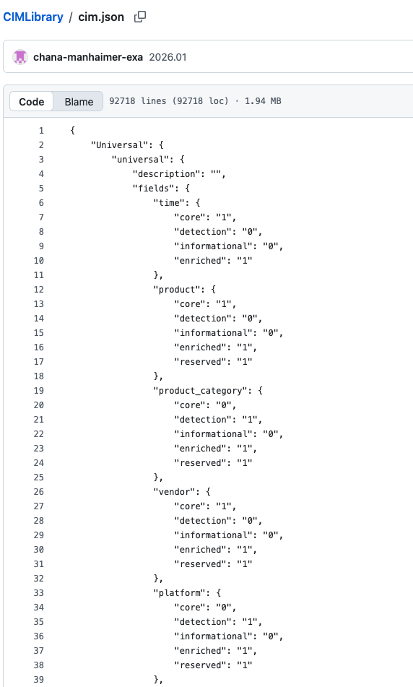
CIM & CIM Library
What is the Common Information Model (CIM)?
A standardized framework for normalizing data (cim.json) from disparate sources.
Enables consistent and unified analysis of security data across different products and vendors.
At Exabeam, CIM is crucial for ensuring that data from various security products can be uniformly processed and analyzed by our platform.
The Structure of CIM
The Blueprint: Defines the organization and relationship of data elements.
Key Components:
  Event Types: Classifications of security events (e.g., authentication, web traffic, malware).
  Fields: Specific data points within an event type (e.g., src_ip, user, action).
  Hierarchy and Relationships: How different event types and fields are related to each other

Slide 4
CIM & CIM Library
What is CIM Library?
The Exabeam Common Information Model Library is a resource that defines the structure of security content across all Exabeam products. It provides a hierarchical framework that dictates how security content is used throughout the entire flow of Exabeam processes.
This model is particularly important when upgrading from older Exabeam products to the New-Scale Security Operations Platform, as it provides the necessary resources to migrate existing content to comply with the new standards.
These resources also include migration mapping information:
Field Mapping by Events: A table that maps old events and fields to the new CIM activity types and fields.
Parser Names Matrix: A set of tables that map old parser names to the new parser names that comply with the CIM.
Metadata Field Mapping: A table that maps old metadata field names to the new CIM-compliant field names.
https://github.com/ExabeamLabs/CIMLibrary

Slide 5
CIM Security Content & Security Content Library
Exabeam Security Content
"Security Content" is a collection of resources used by Exabeam to detect threats and provide security insights.
This content is built on the framework of the Common Information Model and includes:
Parsers: To normalize and extract data from logs.
Rules: For threat detection based on specific conditions.
Models: To establish baseline user and asset behavior.
Event Builders: To construct security events from raw logs.
Enrichment: To add context to security events.
https://github.com/Exabeam/exa_security_nextgen

Slide 6
CIM Security Content & Security Content Library
Security Content Library
For Exabeam's New-Scale platform, this security content is organized in the New-Scale Content Library.
This is an online repository where you can find all the available log source integrations and security use cases.
The library is automatically updated as the threat landscape changes and new content is developed.
https://github.com/ExabeamLabs/Content-Library-CIM2

